Slide 1
Ggplot2 and interactive graphics with R
Christophe Ladroue
SECTION 04
VIDEO 05
BigVis: outliers and smoothing
www.PacktPub.com

Slide 2
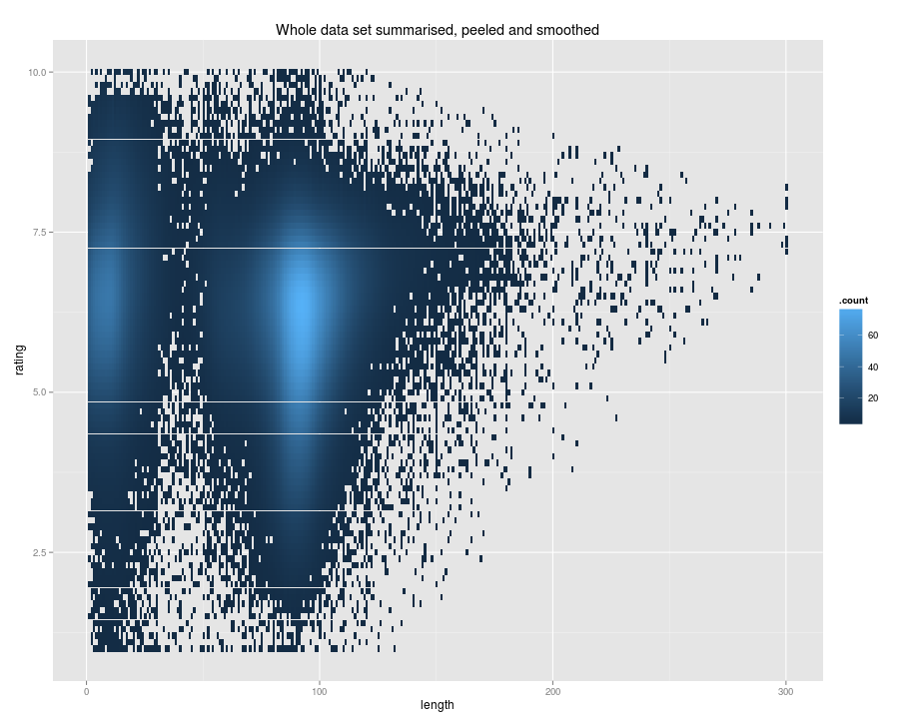
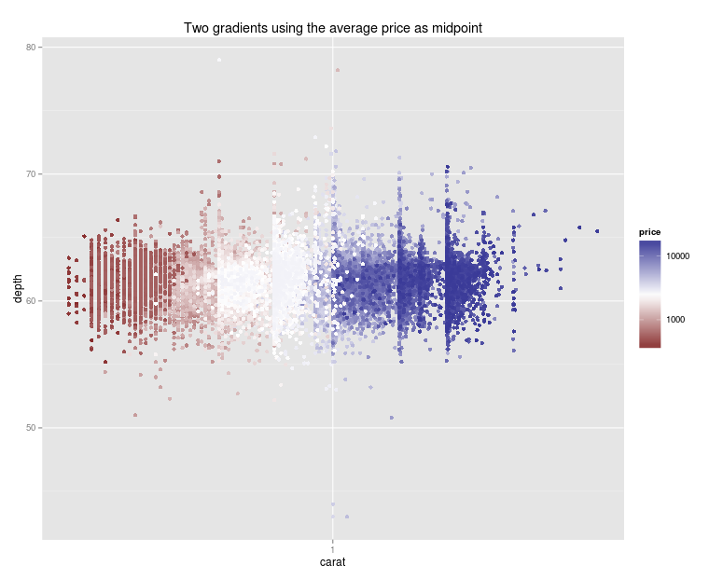
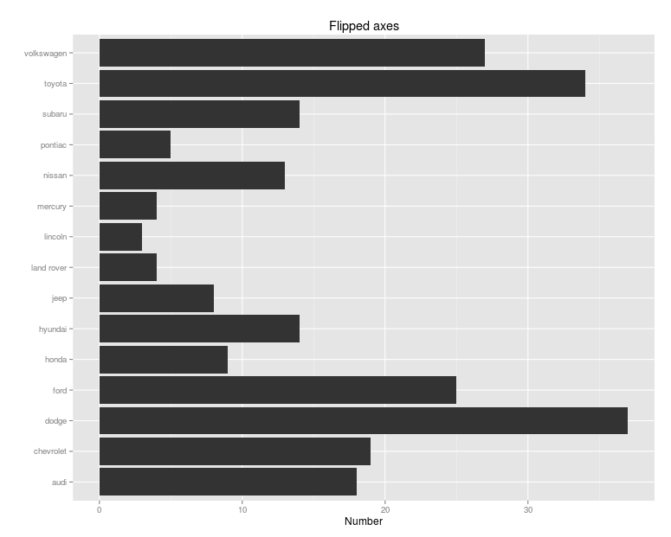
In this video we took a look at
how to automatically remove outliers with peel, and get a better plot.
how to smooth the result to remove possible artefacts and get a nicer-looking plot.
Next: customizing your plots

